Slide 1
Introduction to Project Management
CIS150

Slide 2

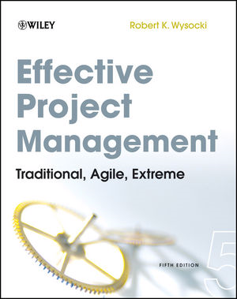
Acknowledgments
Most of the content in this presentation comes from two primary texts
Both are highly recommended

Slide 3
Project Management
Project management is increasingly important to today’s organizations
Large implementations are so complex that they cannot be effectively managed without an established process
Without effective project management, risk of project failure is high
Project management is emerging as a separate discipline of its own
More than 16 million people regard project management as their profession
Project Management Professional (PMP) certification increasingly popular – See Project Management Institute

Slide 4
IT Projects
IT projects may be even hard to manage than most
Software Applications
Complex, integrated, changing – ERP!
Cycle Time
Pressure to release sooner
A 1995 Standish Group study (CHAOS) found that only 16.2% of IT projects were successful in meeting scope, time, and cost goals
31% of IT projects were canceled before completion
A PricewaterhouseCoopers study found that overall, half of all projects fail
Only 2.5% of corporations consistently meet their targets for scope, time, and cost goals for all types of project

Slide 5
Changes in the Project Environment
Traditional Project Management (TPM)
Defined in the domains of engineering and construction
Received clear statements from clients about what, when, and cost
World changed (IT) but TPM did not
Difference between wants and needs
What the client wants is probably not what the client needs!
What impact should this have on PM?
New approaches to software development, such as agile and extreme programming, challenge the TPM approach
Iterative development
Requirements and solutions evolve through collaboration with cross-functional teams

Slide 6
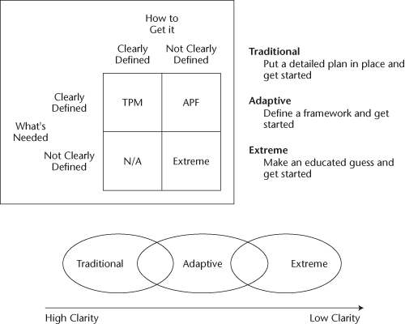
Approaches to Managing a Project

Slide 7
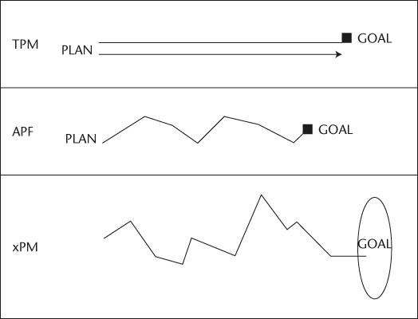
Approaches to Managing a Project

Slide 8
Advantages of Project Management
Following formal process of TPM, APF, or xPM leads to:
Better control of financial, physical, and human resources
Improved customer relations
Shorter development times
Lower costs
Higher quality and increased reliability
Higher profit margins
Improved productivity
Better internal coordination
Higher worker morale

Slide 9
What is a Project?
A project is “a temporary endeavor undertaken to create a unique product, service, or result” (PMBOK® Guide)
Projects involve a sequence of unique, complex, and connected activities having one goal or purpose and that must be completed by a specific time, within budget, and according to specification
Projects end when their objectives have been reached or the project has been terminated
Projects can be large or small and take a short or long time to complete
The project sponsor usually provides the direction and funding for the project

Slide 10
Project Constraints
Five constraints on every project
Scope
Cost
Time
Quality
Resources
Of these, the essential three are scope, cost, and time
The Triple Constraint

Slide 11
The Triple Constraint (Scope Triangle)
Quality and Resources
Scope
Cost
Time

Slide 12
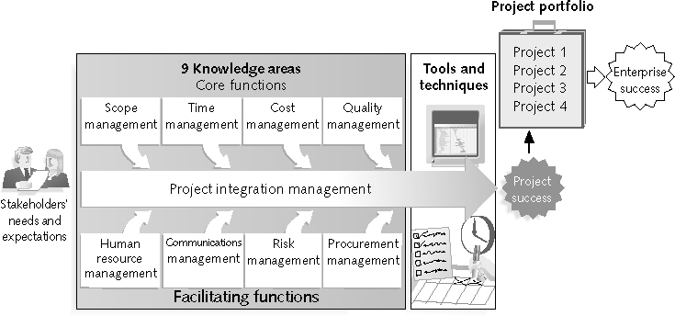
TPM Framework

Slide 13
Project Managers
Project managers need a wide variety of skills
They should:
Be comfortable with change
Understand the organizations they work in and with
Be able to lead teams to accomplish project goals
Job descriptions vary, but most include key responsibilities:
Planning
Leading
Organizing
Controlling
Working with people to achieve project goals

Slide 14
Most Important Skills/Competencies for Project Managers
People skills
Leadership
Listening
Integrity, ethical behavior, consistent
Strong at building trust
Verbal communication
Strong at building teams
Conflict resolution, conflict management
Critical thinking, problem solving
Understands, balances priorities
From “Effective Project Leadership: A Combination of Project Manager Skills and Competencies in Context,” PMI Research Conference Proceedings ( July 2006)

Slide 15
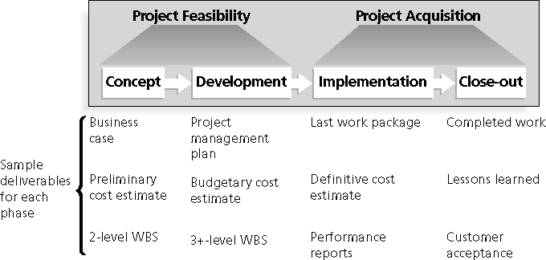
Phases of TPM Life Cycle
TPM processes includes:
Initiating processes
Planning processes
Executing processes
Monitoring and controlling processes
Closing processes

Slide 16
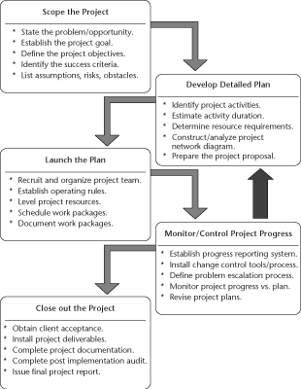
Phases of TPM Life Cycle

Slide 17
Project Initiation
Initiating a project includes recognizing and starting a new project or project phase
The main goal is to formally select and initiate projects
Should develop project charter
Should identify key stakeholders

Slide 18
Project Charter Example
Project Title: Project Management Intranet Site Project
Project Start Date: June 2 Projected Completion Date: December 4
Budget Information: The firm has allocated $150,000 for this project. The majority of costs for this project will be internal labor. An initial estimate provides a total of 80 hours per week.
Project Manager: Jane Smith, (502) 555-1234, jane@fakecompany.com
Project Objectives: Develop a new capability accessible on JWD Consulting’s intranet site to help internal consultants and external customers manage projects more effectively. The intranet site will include several templates and tools that users can download, examples of completed templates and related project management documents used on real projects, important articles related to recent project management topics, an article retrieval service, links to other sites with useful information, and an “ Ask the Expert” feature, where users can post questions they have about their projects and receive advice from experts in the field. Some parts of the intranet site will be accessible free to the public, other parts will only be accessible to current customers and/ or internal consultants, and other parts of the intranet site will be accessible for a fee.
Project Success Criteria: The project should pay for itself within 18 months of completion.
Approach:  Develop a survey to determine critical features of the new intranet site and solicit input from consultants and customers.  Review internal and external templates and examples of project management documents.  Research software to provide security, manage user inputs, and facilitate the article retrieval and “ Ask the Expert” features.  Develop the intranet site using an iterative approach, soliciting a great deal of user feedback.

Slide 19
Project Planning
The main purpose of project planning is to guide execution
Key outputs include:
A team contract
A project scope statement
A work breakdown structure (WBS)
A project schedule, in the form of a Gantt chart with all dependencies and resources entered
A list of prioritized risks

Slide 20
Examples of Risk Factors
Technological
Rapidly changing
Environmental
High staff turnover rates
Interpersonal
Poor working relationships between teammates or stakeholders
Cultural
Project inconsistent with existing corporate culture
Causal Relationships
Assumptions about cause and effect

Slide 21
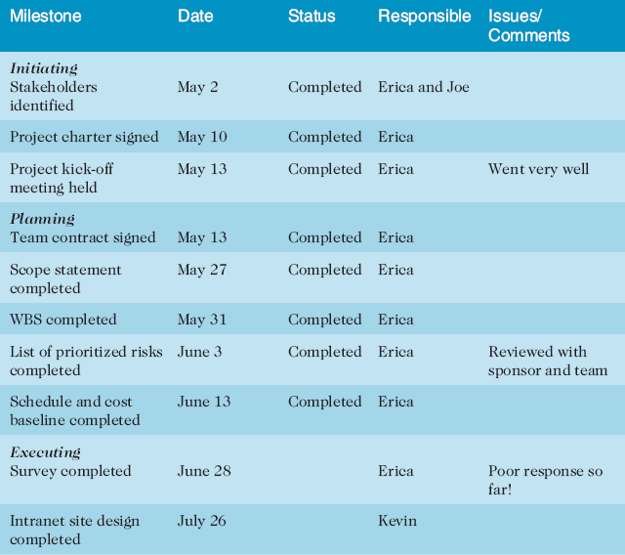
Executing the Project
Usually takes the most time and resources to perform project execution
Project managers must use their leadership skills to handle the many challenges that occur during project execution
A milestone report can help focus on completing major project milestones

Slide 22
Monitor/Control Project Progress
Involves measuring progress toward project objectives, monitoring deviation from the plan, and taking correction actions
Affects all other process groups and occurs during all phases of the project life cycle
Outputs include performance reports, change requests, and updates to various plans
Status reports are used to monitor project’s progress
Some only for project team, others shared with management and customer
Change Management is critical
May require re-planning, hence, the feedback loop in life cycle

Slide 23
Close Out the Project
Customer says project is complete
Deliverables get installed
Final reports and documentation filed
Perform a post-implementation review (costs and benefits, approach, tools, resources, lessons learned, best practices)
Celebrate success!
Even if projects are not completed, they should be closed out to learn from the past
Outputs include project archives and lessons learned, part of organizational process assets

Slide 24
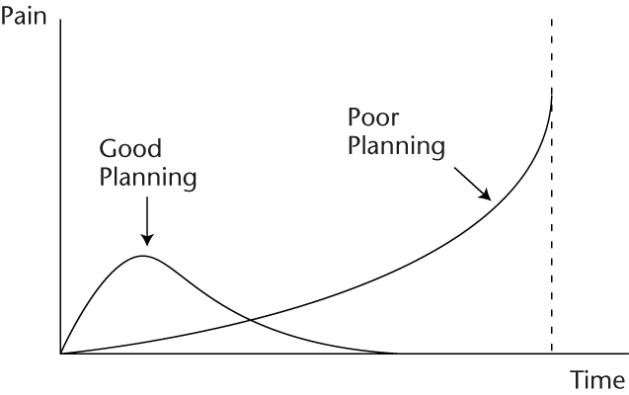
The Pain Curve

Slide 25
Scope Management

Slide 26
What is Scope Management?
Scope refers to all the work involved in creating the products of the project and the processes used to create them
A deliverable is a product produced as part of a project, such as hardware or software, planning documents, or meeting minutes
Scope management includes the processes involved in defining and controlling what is or is not included in a project

Slide 27
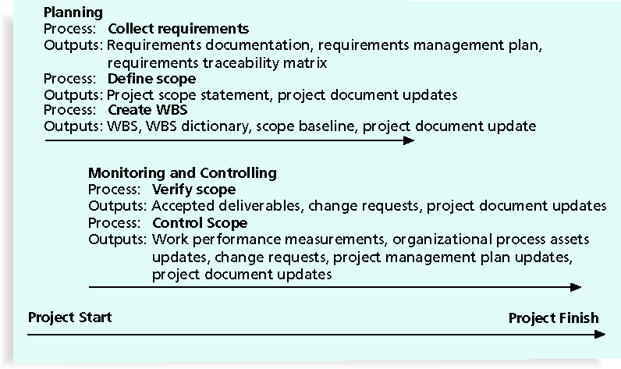
Scope Management Overview

Slide 28
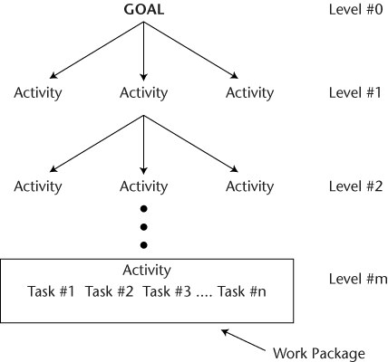
Work Breakdown Structure (WBS)
The Work Breakdown Structure (WBS) is a hierarchical description of the work that must be done to complete the project

Slide 29
Uses for the WBS
Thought process tool
It helps the project manager and the project team visualize exactly how the work of the project can be defined and managed effectively
Not unusual to consider alternative ways of decomposing the work until project manager is comfortable
Architectural design tool
Is a picture of the work of the project and how the items of work are related to one another
Planning tool
Gives the project team a detailed representation of the project as a collection of activities that must be completed in order for the project to be completed
Project status reporting tool
Project activities are consolidated (rolled up) from the bottom as lower-level activities are completed
As work is completed, activities will be completed
Some of these higher-level activities may represent significant progress whose completion will be milestone events in the course of the project
WBS defines milestone events that can be reported to senior management and to the customer

Slide 30
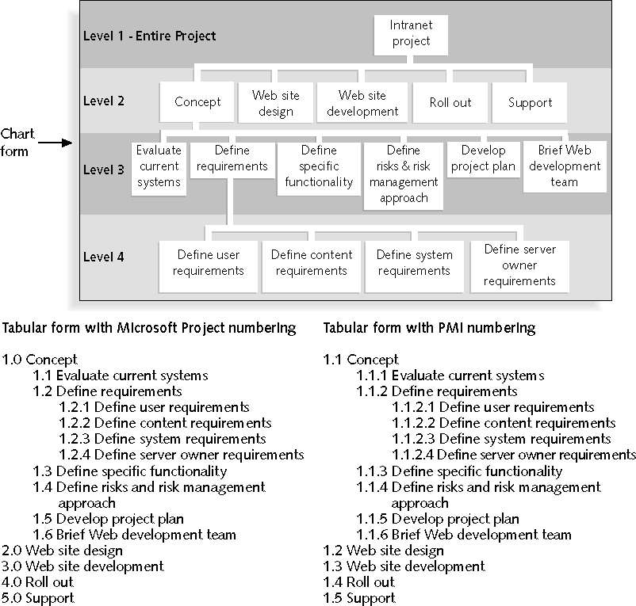
WBS Example

Slide 31
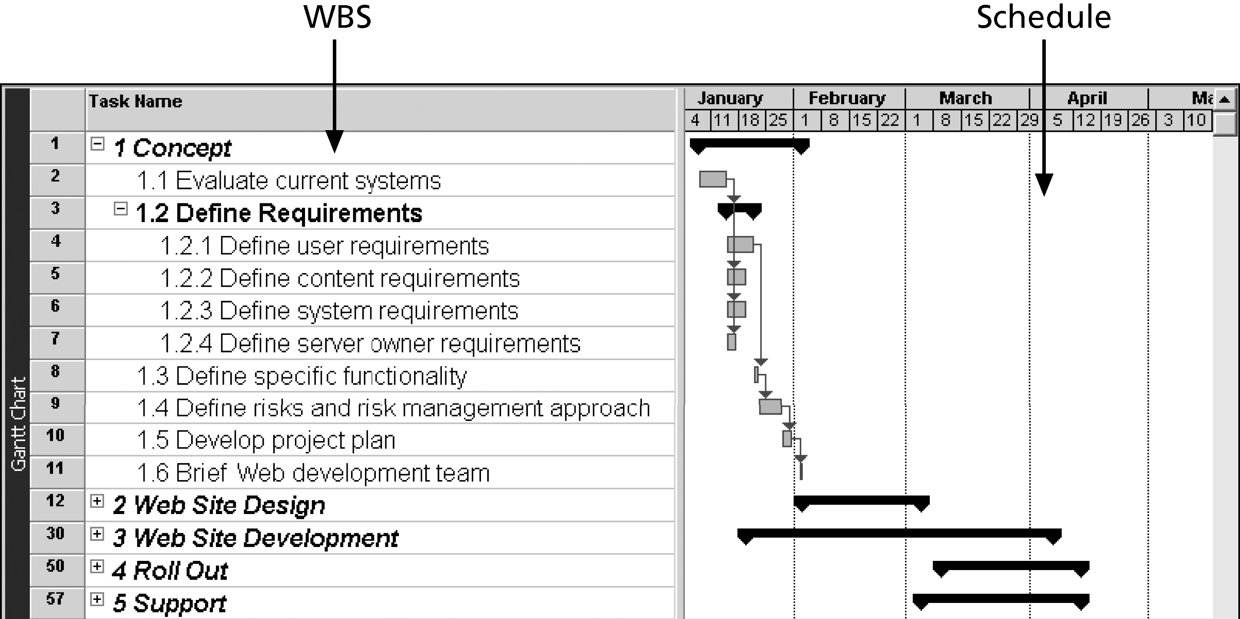
WBS with Gantt Chart Example

Slide 32
Suggestions for Avoiding Scope Problems
Keep the scope realistic
Don’t make projects so large that they can’t be completed
Break large projects down into a series of smaller ones
Involve users in project scope management
Assign key users to the project team and give them ownership of requirements definition and scope verification
Use off-the-shelf hardware and software whenever possible
Many IT people enjoy using the latest and greatest technology, but business needs, not technology trends, must take priority
Follow good project management processes

Slide 33
Use Software to Assist Scope Management
Word-processing software helps create several scope-related documents
Spreadsheets help to perform financial calculations and weighted scoring models and to develop charts and graphs
Communication software like e-mail and the Web help clarify and communicate scope information
Project management software, such as Microsoft Project, helps in creating a WBS, the basis for tasks on a Gantt chart
Specialized software is available to assist in project scope management

Slide 34
Time Management

Slide 35
Importance of Project Schedules
Managers often cite delivering projects on time as one of their biggest challenges
Time has the least amount of flexibility; it passes no matter what happens on a project
Schedule issues are the main reason for conflicts on projects, especially during the second half of projects
Different cultures and even entire countries have different attitudes about schedules

Slide 36
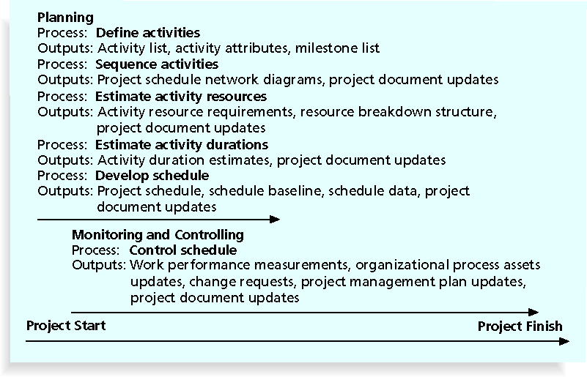
Time Management Overview

Slide 37
Defining Activities
An activity or task is an element of work normally found on the work breakdown structure (WBS) that has an expected duration, a cost, and resource requirements
Activity definition involves developing a more detailed WBS and supporting explanations to understand all the work to be done so you can develop realistic cost and duration estimates

Slide 38
Estimating Duration
Duration is the elapsed time in business working days, not including weekends, holidays, or other non-work days
Work effort is labor required to complete an activity
Can be consecutive or nonconsecutive hours

Slide 39
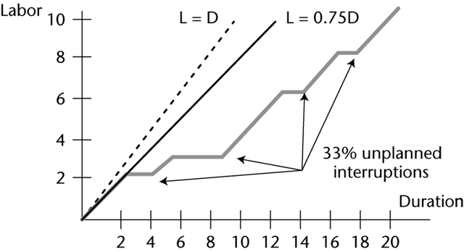
Elapsed Time vs. Work Time

Slide 40
Resource Loading vs. Activity Duration
Duration of an activity is influenced by the amount of resources scheduled to work on it
Not necessarily a direct linear relationship between the amount of resource assigned to an activity and its duration
Adding more resources to hold an activity’s duration within the planning limits can be effective
But diminishing returns for adding more resources
Especially true of software projects
Remember Case of the Killer Robot
Several causes of variation in the actual activity duration:
Varying skill levels
Base on using people resource of average skill levels
Unexpected events
Efficiency of work time
Mistakes and misunderstandings

Slide 41
Estimating Activity Duration
Similarity to other activities
Extrapolate based on recollections of similar activities
Historical data
Based on project notebook records of estimated and actual duration
Can be sophisticated DB search with regression
Expert advice
Vendors and noncompetitors may prove good source
Three-point technique
Need three estimates of activity duration:
Optimistic
The shortest duration one might expect to experience given that everything happens as expected
Pessimistic
The duration that would be experienced if everything that could go wrong did go wrong, yet the activity was completed
Most likely
The time usually experienced

Slide 42
Duration as a Function of Resource Availability
PM software will let you enter two and calculate the other
Assign as a total work and constant percent/day
40 hours @ 50% = 80 hours duration
Assign as a duration and total work effort
5 days effort / 10 days duration = 50%
Assign as a duration and percent/day
10 days duration @ 50% = 5 days effort
Assign as a profile
Useful when not flat-loaded at constant rate

Slide 43
Sequencing Activities
Could perform the project activities one at a time until they are all complete
Simple, but would result in the longest time to complete the project
Any ordering that allowed even one pair of activities to be worked on concurrently would result in faster completion
Another approach is to establish a network of relationships between the activities
What activities must be complete before another activity can begin?
Or, now that a set of activities is complete, what activity or activities could come next?
A dependency or relationship is the sequencing of project activities or tasks

Slide 44
Types of Dependencies
Mandatory dependencies: inherent in the nature of the work being performed on a project, sometimes referred to as hard logic
Discretionary dependencies: defined by the project team; sometimes referred to as soft logic and should be used with care since they may limit later scheduling options
External dependencies: involve relationships between project and non-project activities

Slide 45
Network Diagrams
A network diagram is a schematic display of the logical relationships among, or sequencing of, project activities
Benefits
Planning
Even for large projects, the project network diagram gives a clear graphical picture of the relationship between project activities.
Implementation
As you update the project file with activity status and estimate-to-completion data, network diagram is automatically updated
The need for rescheduling and resource reallocation decisions can be determined from the network diagram
Control
While the updated network diagram retains the status of all activities, the best graphical report for monitoring and controlling project work will be the Gantt chart view of the network diagram
Gantt chart cannot be used for control purposes unless you have done network scheduling or incorporated the logic into the Gantt chart
Comparing the planned schedule with the actual schedule, the project manager will discover variances and will be able to react

Slide 46
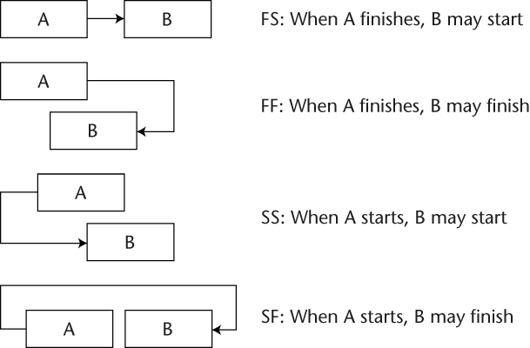
Precedence Diagramming Method
Activities are represented by boxes
Arrows show relationships between activities
Types of task dependencies

Slide 47
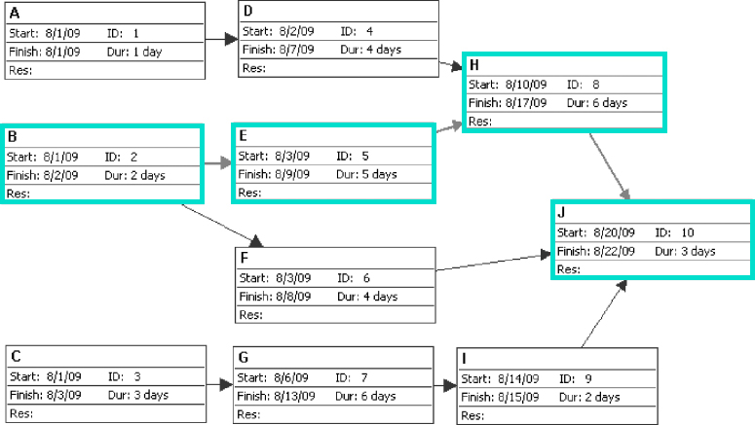
Network Diagram Example
Notes:
Critical Path is highlighted

Slide 48
Critical Path Method
Network diagramming technique used to predict total project duration
A critical path for a project is the series of activities that determines the earliest time by which the project can be completed
The critical path is the longest path through the network diagram and has the least amount of slack or float
Slack or float is the amount of time an activity may be delayed without delaying a succeeding activity or the project finish date

Slide 49
Using Critical Path to Shorten Project Schedule
Three main techniques for shortening schedules
Shortening durations of critical activities/tasks by adding more resources or changing their scope
Crashing activities by obtaining the greatest amount of schedule compression for the least incremental cost
Fast tracking activities by doing them in parallel or overlapping them
Look for pairs of activities that allow you to convert activities that are currently worked on in series into more parallel patterns of work
Work on the successor activity might begin once the predecessor activity has reached a certain stage of completion
In many cases, some of the deliverables from the predecessor can be made available to the successor so that work might begin on it

Slide 50
Suggestions for Avoiding Schedule Problems
Perform reality checks on schedules
Allow for contingencies
Don’t plan for everyone to work at 100% capacity all the time
Hold progress meetings with stakeholders and be clear and honest in communicating schedule issues

Slide 51
Cost Management

Slide 52
Importance of Cost Management
IT projects have a poor track record for meeting budget goals
The CHAOS studies found the average cost overrun ranged from 180 percent in 1994 to 56 percent in 2004; other studies found overruns to be 33-34 percent
Cost is a resource sacrificed or foregone to achieve a specific objective or something given up in exchange
Usually measured in monetary units like dollars
Project cost management includes the processes required to ensure that the project is completed within an approved budget

Slide 53
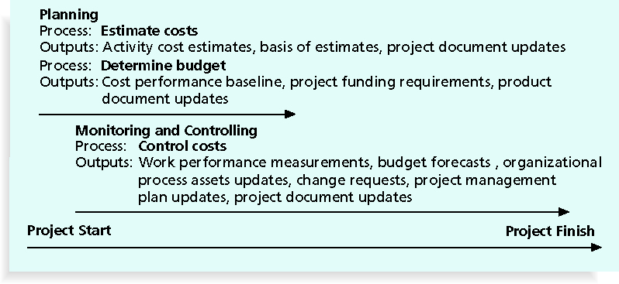
Cost Management Overview

Slide 54
Basic Principles of Cost Management
Tangible costs or benefits are those costs or benefits that an organization can easily measure in dollars
Intangible costs or benefits are costs or benefits that are difficult to measure in monetary terms
Direct costs are costs that can be directly related to producing the products and services of the project
Indirect costs are costs that are not directly related to the products or services of the project, but are indirectly related to performing the project
Sunk cost is money that has been spent in the past; when deciding what projects to invest in or continue, you should not include sunk costs
Reserves are dollars included in a cost estimate to mitigate cost risk by allowing for future situations that are difficult to predict

Slide 55
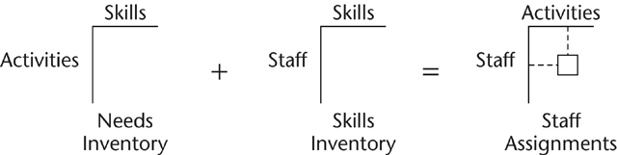
Estimating Cost
Resource Planning
Adding resources doesn’t necessarily mean that you will shorten the time needed for various activities
Adding too many people can actually add time to the project
Must also consider skill level
May trade money for time by using lower skill level staff
Skills Matrices

Slide 56
Typical Problems with Cost Estimates
Estimates are done too quickly
Developing an estimate for a large software project is a complex task but many estimates must be done before clear system requirements have been produced
Lack of estimating experience
Often not enough accurate, reliable project data available on which to base estimates
Human beings are biased toward underestimation
Experienced professionals might make estimates based on their own abilities and forget that many junior people will be working on a project

Slide 57
Controlling Costs
Project cost control includes:
Monitoring cost performance
Ensuring that only appropriate project changes are included in a revised cost baseline
Informing project stakeholders of authorized changes to the project that will affect costs
Earned Value Management is a project performance measurement technique that integrates scope, time, and cost data
Given a baseline, you can determine how well the project is meeting its goals

Slide 58
Adaptive Project Framework and Extreme Project Management

Slide 59
Introduction to APF
APF represents a shift in thinking about projects and how they should be run
APF eliminates all of the non-value-added work time that is wasted on planning activities that are never performed
Why plan the future when you don’t know what it is?
In APF, planning is done just-in-time
APF is a new mind-set; one that thrives on change rather than one that avoids change
APF continuously adapts to the unique character of the specific business situation as it learns more about that business situation
APF adapts some of the tools and processes from TPM and extreme project management to its own special needs
APF ensures maximum business value for the time and dollars expended and has squeezed out all of the non-value-added work that it possibly could
APF meaningfully and fully engages the client as the primary decision maker, creating a shared partnership with shared responsibility between requestor and provider

Slide 60
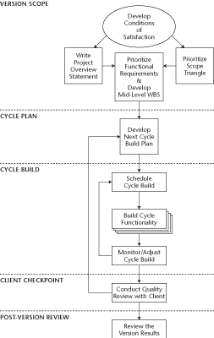
Overview of APF

Slide 61
APF Core Values
APF is more than just a framework - represents a way of thinking about clients and how best to serve them
This way of thinking is embodied in the six core values noted below
These core values are immutable and must be practiced in every APF project with no exceptions
Client-Focused
Client-Driven
Incremental Results Early and Often
Continuous Questioning and Introspection
Change is Progress to a Better Solution
Don’t Speculate on the Future

Slide 62
Extreme Project Management
xPM handles the situation where the goal is not clearly defined and therefore the solution cannot be defined either
On the continuum of project management approaches, the traditional approach occupies the structured end, where there is the most clarity with respect to both the goal and the solution
xPM is at the unstructured end, where there is the least clarity with respect to the goal and the solution
APF occupies the middle ground

Slide 63
Defining an Extreme Project
The best way to define an extreme project is to consider its characteristics:
High Speed
High Change
High Uncertainty
These characteristics will strike fear into the hearts of most project managers!
Make no mistake, extreme projects are extremely challenging and their failure rate will be high
For those that are successful, what they deliver may not at all reflect what they thought they would deliver
The actual goal achieved may be quite different than the goal that was originally envisioned

Slide 64
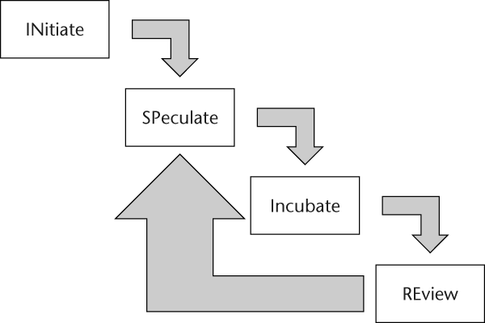
Overview of xPM
INSPIRE

Slide 65
Overview of xPM
xPM requires the client to be more involved within and between cycles, whereas APF requires client involvement between cycles
More than likely the project team will begin by choosing some investigative direction or directions and hope that intermediate findings and results will do two things:
That the just finished cycle will point to a more informed and productive direction for the next and future cycles
Most important of all, that the funding agent will see this learning and discovery as potentially rewarding and will decide to continue the funding support
There is no constrained scope triangle in xPM as there is in TPM and APF projects
Recall that those TPM and APF projects have a built-in stopping rule
When the money or the time runs out, the project is over
xPM does have stopping rules, but they are very different:
The first one says that the project is over when the solution is found - Success!
The second one says the project is over when the sponsor is not willing to continue the funding - Failure!

Slide 66
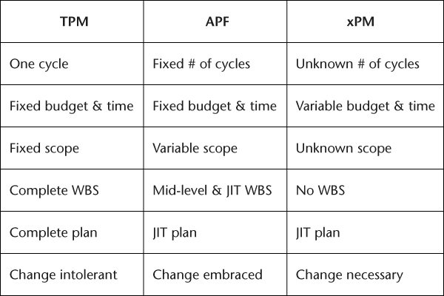
Comparing PM Approaches

